Slide 1
Channel 1
Channel name
Channel 2
Channel 3
Channel 4
Channel 5
Channel 6
Channel 7
Channel 8
Channel 9
Channel 10
Channel 11
Channel 12

Slide 2
Channel name
Channel 1
Channel 2
Channel 3
Channel 4
Channel 5
Channel 6

Slide 3
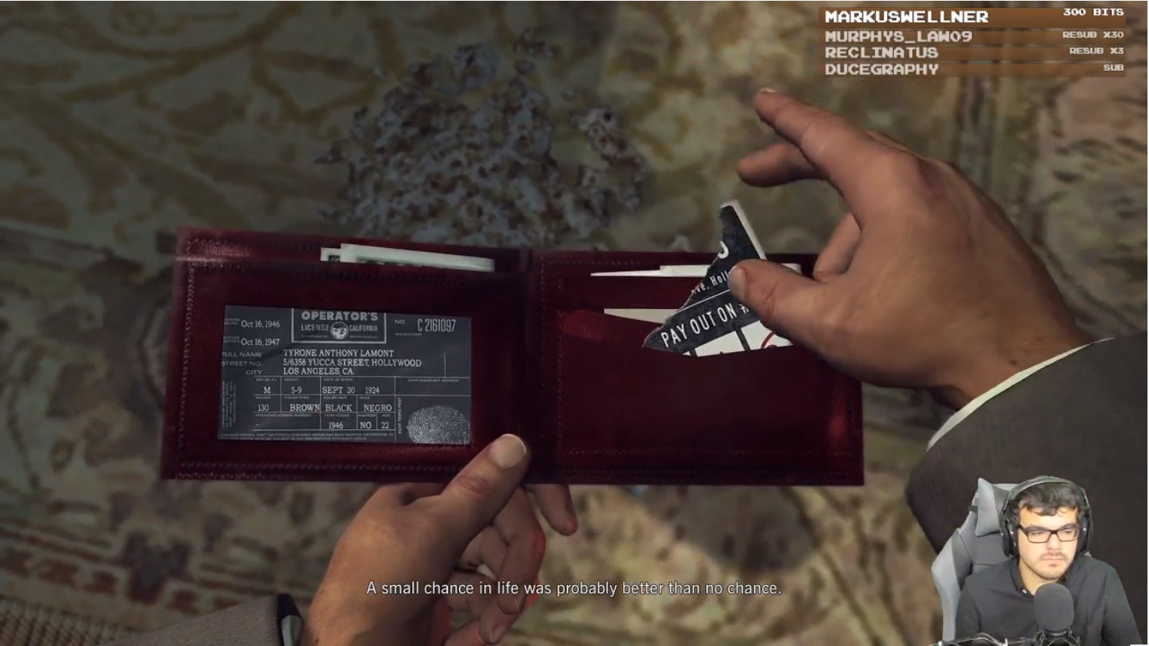
Whateber
BrownMan
Channel name
Blah
askljfkd
Lorem
Ypu
AGDQ
klsdaf
Fill in here
Twitch Presents
SGDQ
A+
Link

Slide 4

Account Name
Followed Channels
AGDQ*
Snake*
Whatever*
Blah*

Slide 5


Beret
Whateber
BrownMan
Channel name
Followed Channels
Blah
AGDQ*
askljfkd
Lorem
Snake*
Ypu
Whatever*
AGDQ
BrownMan*
klsdaf
Fill in here
Twitch Presents
SGDQ
A+
Link

Slide 7

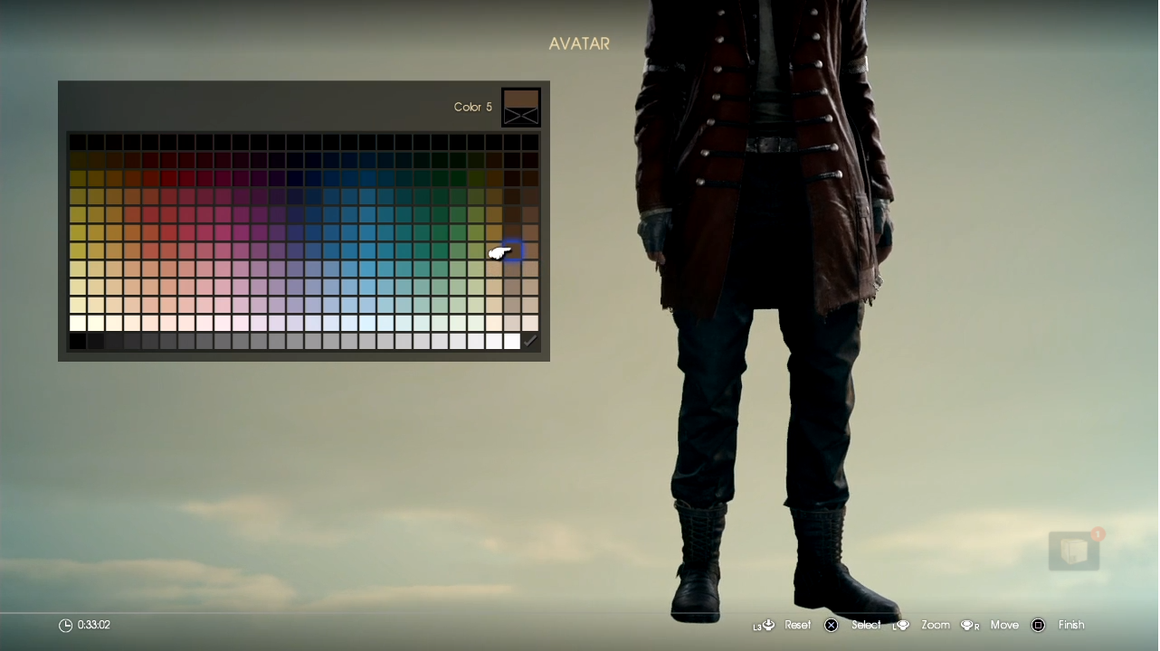
Snake | Archive | Events | Followers 48,026 | Following 21 Subscribe | Bits
The Box: Guy Fieri Edition*
Final Fantasy XV 255 1,039,011
■


